Slide 1



Learning Using
Augmented Error Criterion
Yadunandana N. Rao
Advisor: Dr. Jose C. Principe

Slide 2
Overview
AEC
Criterion
MSE
Linear
Adaptive
Systems
AEC
Algorithms
Algorithm
LMS/RLS
Topology
FIR, IIR

Slide 3


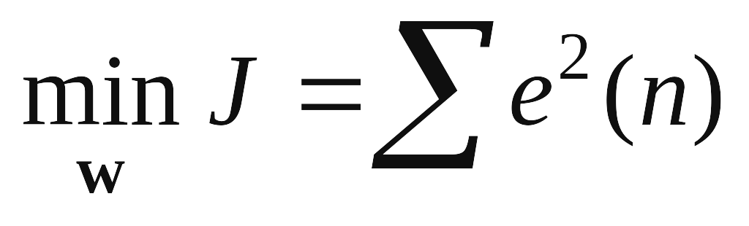
Why another criterion?
MSE gives biased parameter estimates with noisy data
u(n)
v(n)
d(n)
+
Adaptive Filter
+
x(n)
+
+
e(n)
-
w
T. Söderström, P. Stoica. “System Identification.” Prentice-Hall, London, United Kingdom, 1989.

Slide 4
Is the Wiener-MSE solution optimal?
Assumptions:
1. v(n), u(n) are uncorrelated with input & desired
2. v(n) and u(n) are uncorrelated with each other
white input noise:
W=(R+σ²I)⁻¹P
Unknown σ²
colored input noise:
W=(R+V)⁻¹P
Unknown V
Solution will change with changing noise statistics

Slide 5
An example
2
RLS
1.5
Input SNR = 0dB
True
1
0.5
0
-0.5
-1
-1.5
-2
0
5
10
15
20
25
30
35
40
45
50
taps

Slide 6
Existing solutions…
Total Least Squares
Gives exact unbiased estimate
iff
v(n) and u(n) are iid with
equal variances !!
Input is noisy and desired is noise-free
Y.N. Rao, J.C. Principe. “Efficient Total Least Squares Method for System Modeling using Minor Component Analysis.” IEEE Workshop on Neural Networks for Signal Processing XII, 2002.

Slide 7
Existing solutions …
Extended Total Least Squares
Gives exact unbiased estimate
with colored v(n) and u(n)
iff
noise statistics are known!!
J. Mathews, A. Cichocki. “Total Least Squares Estimation.” Technical Report, University of Utah, USA and Brain Science Institute Riken, 2000.

Slide 8
Going beyond MSE - Motivation
Assumption:
1. v(n) and u(n) are white
The input covariance matrix is,
R=R_{x}+σ²I
Only the diagonal terms are corrupted!
We will exploit this fact

Slide 9
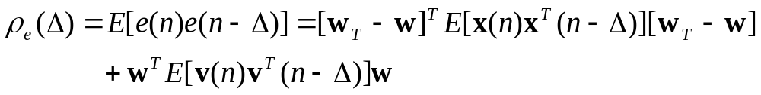
Going beyond MSE - Motivation
w = estimated weights ( length L )
w_{T} = True weights ( length M )
If Δ ≥ L, w = w_{T} ρ_{e}(Δ) = 0
J.C. Principe, Y.N. Rao, D. Erdogmus. “Error Whitening Wiener Filters: Theory and Algorithms.” Chapter-10, Least-Mean-Square Adaptive Filters, S. Haykin, B. Widrow, (eds.), John Wiley, New York, 2003.

Slide 10

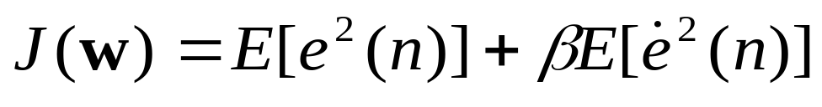
Augmented Error Criterion (AEC)
Define
AEC
MSE
Error penalty

Slide 11
AEC can be interpreted as…
β > 0
  Error constrained (penalty) MSE
  Error smoothness constraint
  Joint MSE and error entropy

Slide 12
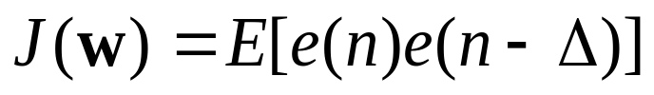
From AEC to Error Whitening
β < 0
  Simultaneous minimization of MSE and maximization of error entropy
With β = -0.5, AEC cost function reduces to,
When J(w) = 0, the resulting w
partially whitens the error signal!
and is unbiased (Δ>L) even with white noise

Slide 13
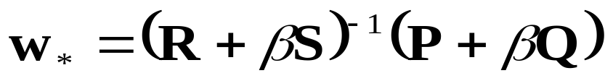
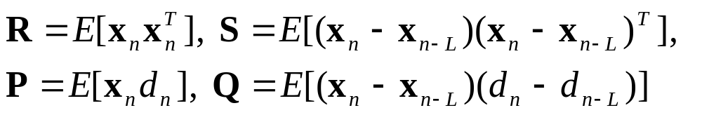
Optimal AEC solution w*
Irrespective of β, the stationary point of the
AEC cost function is
Choose a suitable lag L

Slide 14
In summary AEC…
β=0
β=-0.5
β>0
MSE
EWC
AEC
Minimization
Root finding!
Minimization
Shape of Performance Surface

Slide 15
Searching for AEC-optimal w
β>0
1
0.8
0.6
0.4
0.2
w
2
0
-0.2
-0.4
-0.6
-0.8
-1
-1
-0.8
-0.6
-0.4
-0.2
0
0.2
0.4
0.6
0.8
1
w
1

Slide 16
Searching for AEC-optimal w
β<0
1
0.8
0.6
0.4
0.2
w
2
0
-0.2
-0.4
-0.6
-0.8
-1
-1
-0.8
-0.6
-0.4
-0.2
0
0.2
0.4
0.6
0.8
1
w
1

Slide 17
Searching for AEC-optimal w
β<0
1
0.8
0.6
Decreasing
0.4
0.2
w
2
0
-0.2
Increasing
-0.4
-0.6
-0.8
-1
-1
-0.8
-0.6
-0.4
-0.2
0
0.2
0.4
0.6
0.8
1
w
1

Slide 18
Stochastic search – AEC-LMS
Problem
The stationary point for AEC with β < 0 can be a
global min, global max or a saddle point
Theoretically, a saddle point is unstable and a single sign step-size can never converge to a saddle point
Use sign information

Slide 19
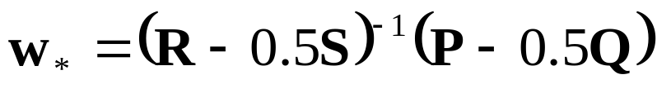
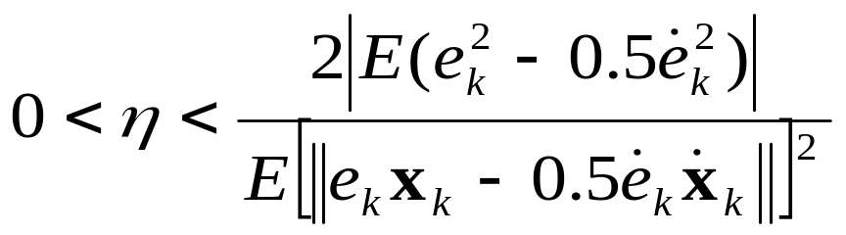
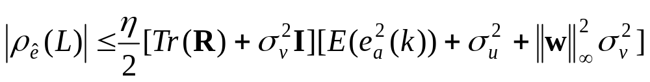
AEC-LMS: β = -0.5
Convergence in MS sense iff
Y.N. Rao, D. Erdogmus, G.Y. Rao, J.C. Principe. “Stochastic Error Whitening Algorithm for Linear Filter Estimation with Noisy Data.” Neural Networks, June 2003.

Slide 20
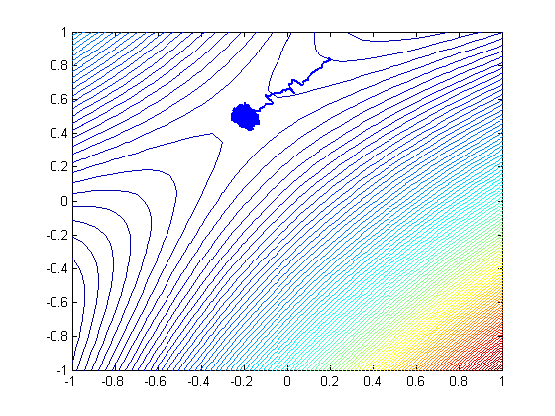


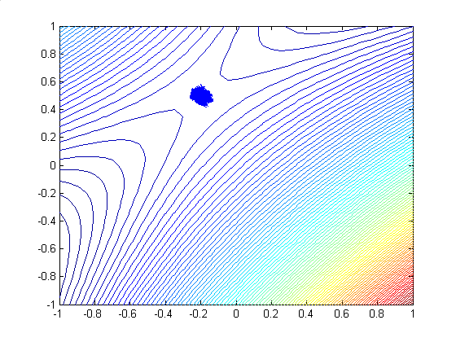
SNR: 10dB

Slide 21
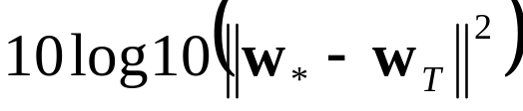
Noisy system ID with EWC-LMS
Problem
Given an input and output time series, estimate
the parameters of the unknown system
Metric
Error norm =

Slide 22
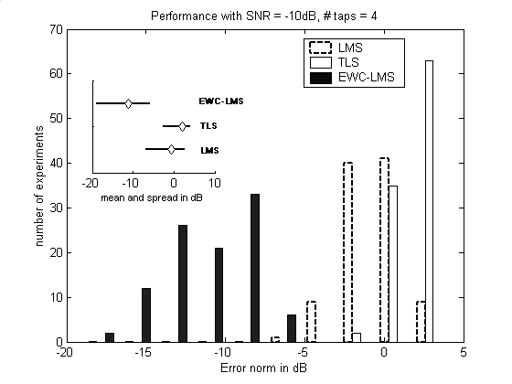
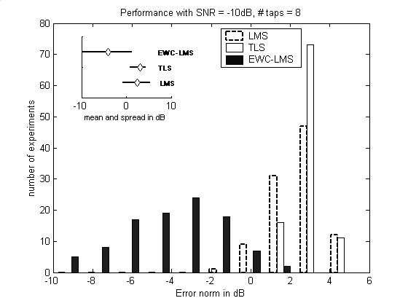

Slide 23
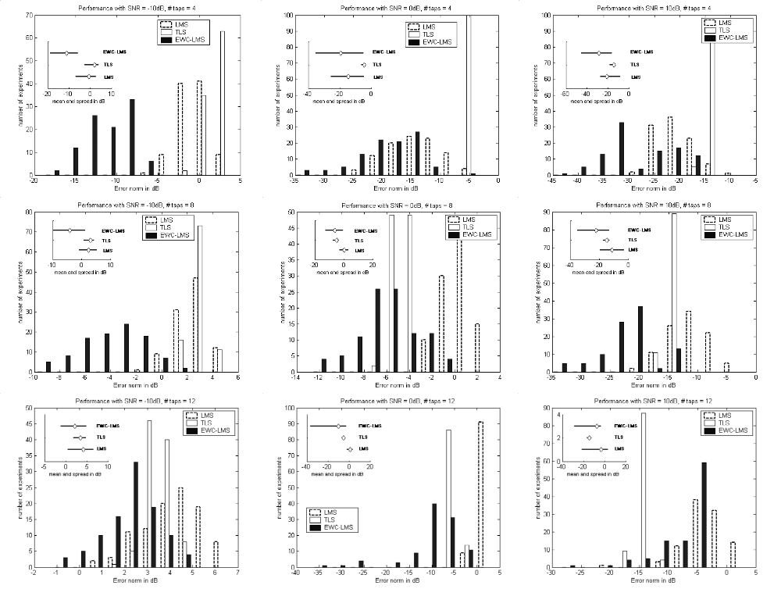

Slide 24
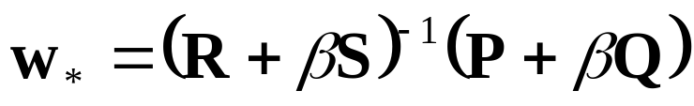
Quasi-Newton AEC
Problem
Optimal solution requires matrix inversion
Solution
Matrices R and S are positive-definite, symmetric and allow rank-1 recursion
Overall, T = R + βS has a rank-2 update

Slide 25

Quasi-Newton AEC
T(n) = R(n) + βS(n)
Use Sherman-Morrison-Woodbury identity
Y.N. Rao, D. Erdogmus, G.Y. Rao, J.C. Principe. “Fast Error Whitening Algorithms for System Identification and Control.” IEEE Workshop on Neural Networks for Signal Processing XIII, September 2003.

Slide 26
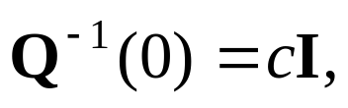


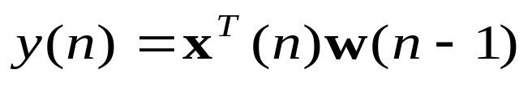
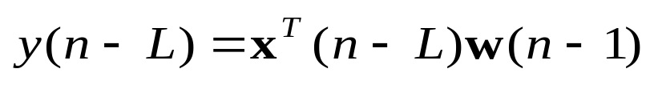
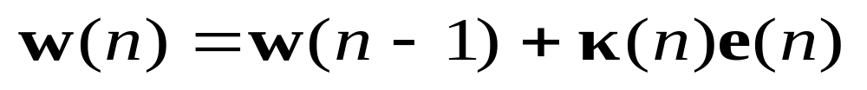
Quasi-Newton AEC
Initialize c is a large positive constant
Initialize
At every iteration, compute

Slide 27
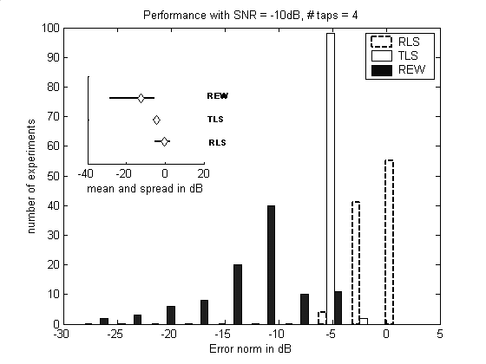
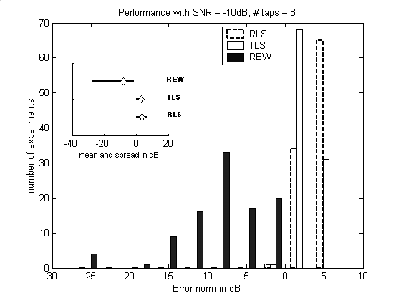

Slide 28
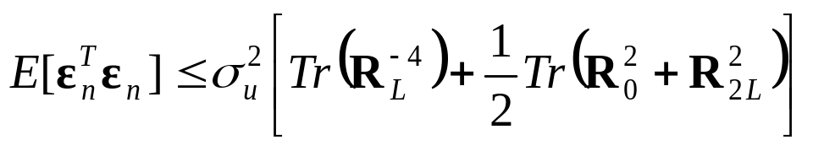
Quasi-Newton AEC analysis
Fact 1: Convergence achieved in finite number of steps
Fact 2: Estimation error covariance is bound from above
Fact 3: Trace of error covariance is mainly dependent on the smallest eigenvalue of R+βS
Y.N. Rao, D. Erdogmus, G.Y. Rao, J.C. Principe. “Fast Error Whitening Algorithms for System Identification and Control with Noisy Data.” NeuroComputing, to appear in 2004.

Slide 29
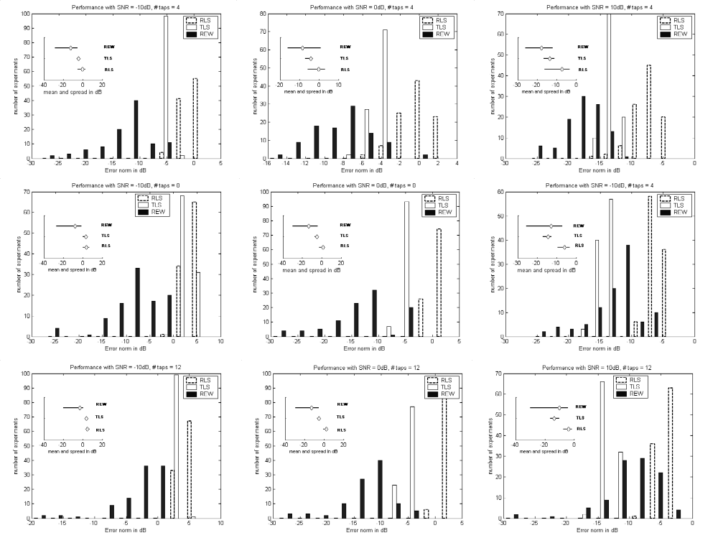

Slide 30
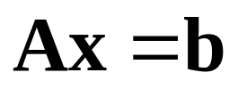
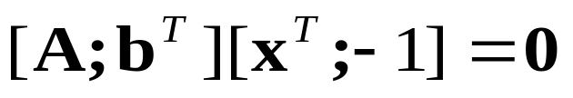
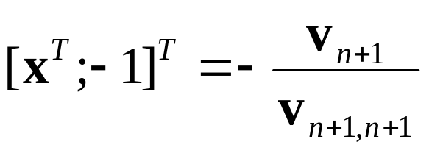
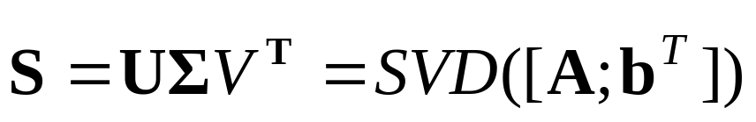
Minor Components based EWC
Formulate EWC using TLS principles
The vector x that minimizes [A;b^{T}][x^{T};-1] is

Slide 31
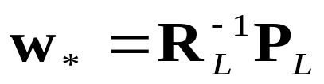
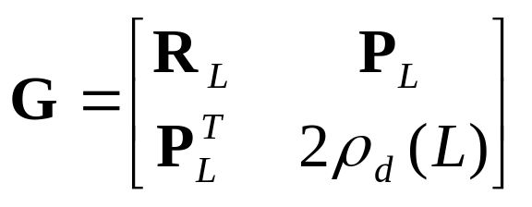
Minor Components based EWC
Optimal EWC solution
motivated from TLS
Augmented Data Matrix
Symmetric, indefinite matrix

Slide 32
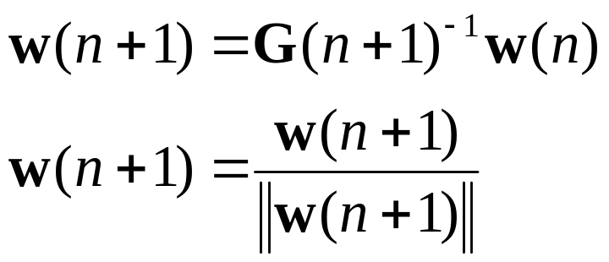
Minor Components based EWC
Problem
Computing eigenvector corresponding to zero eigenvalue of an indefinite matrix
Inverse iteration
EWC-TLS
Y.N. Rao, D. Erdogmus, J.C. Principe. “Error Whitening Criterion for Adaptive Filtering: Theory and Algorithms.” IEEE Transactions on Signal Processing, to appear.

Slide 33
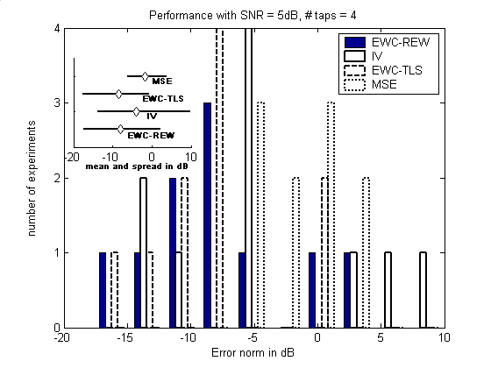
Comparisons

Slide 34
Inverse control using EWC
Reference
Model
-
Adaptive
controller
Plant
(model)
noise
AR
plant
FIR
model

Slide 35
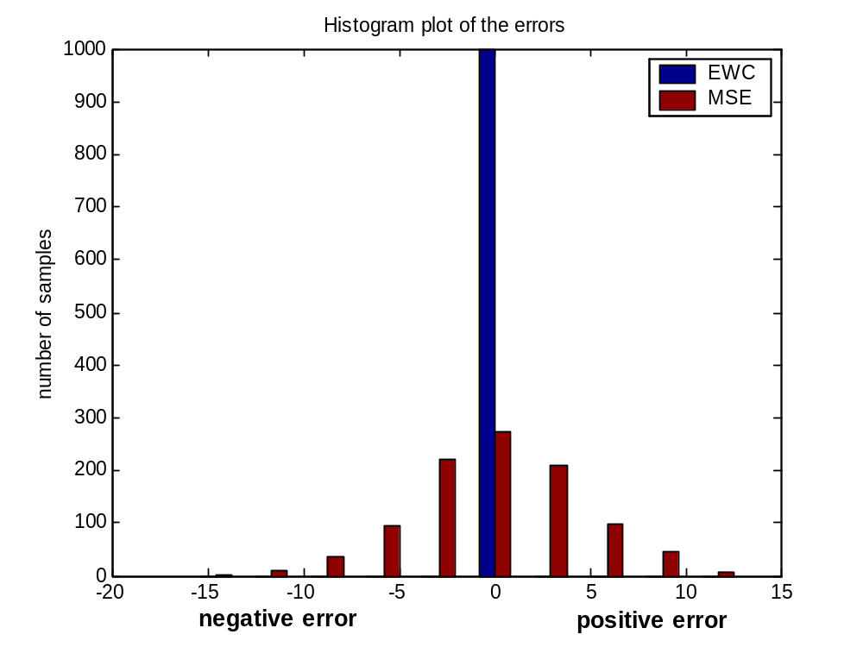
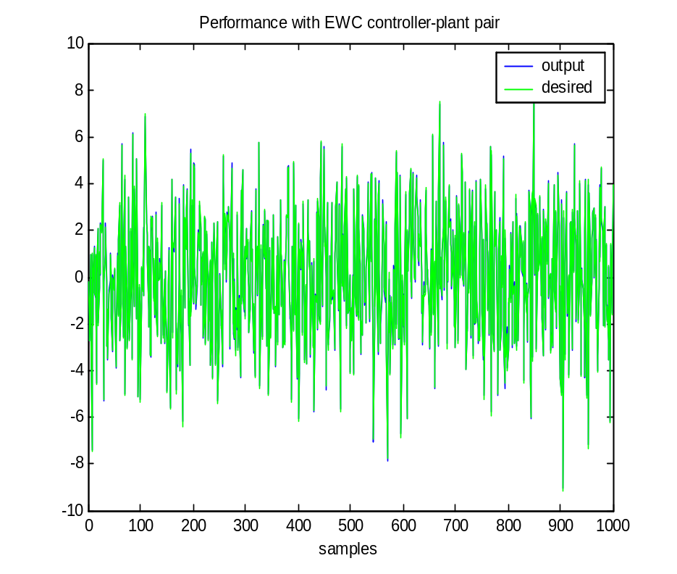
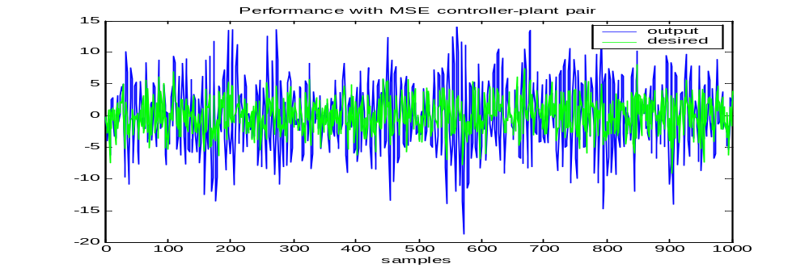

Slide 36
Going beyond white noise…
EWC can be extended to handle colored noise if
  Noise correlation depth is known
  Noise covariance structure is known
Otherwise the results will be biased by the noise terms
Exploit the fact that the output and desired signals have independent noise terms

Slide 37
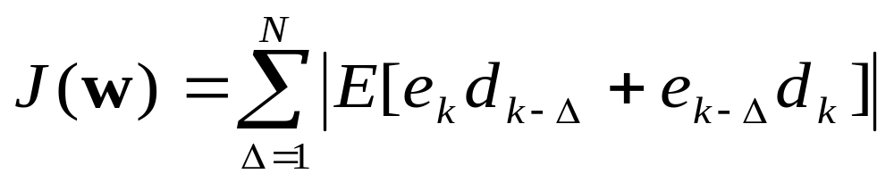
Modified cost function
N – filter length (assume sufficient order)
e – error signal with noisy data
d – noisy desired signal
Δ – lags chosen (need many!)
Y.N. Rao, D. Erdogmus, J.C. Principe. “Accurate Linear Parameter Estimation in Colored Noise.” International Conference on Acoustics, Speech and Signal Processing, May 2004.

Slide 38
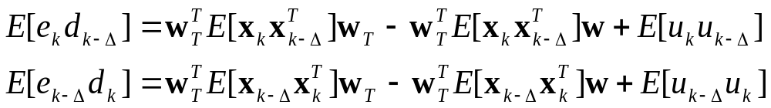

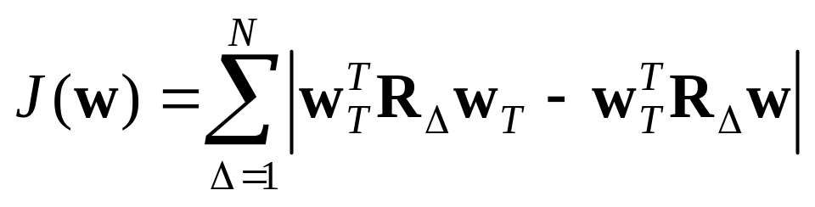
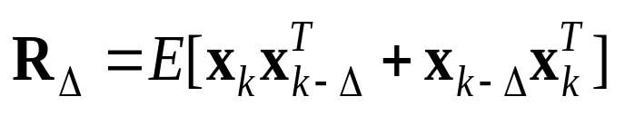
Cost function…
If noise in the desired signal is white
Input Noise drops out completely!

Slide 39

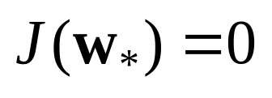
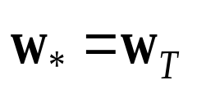
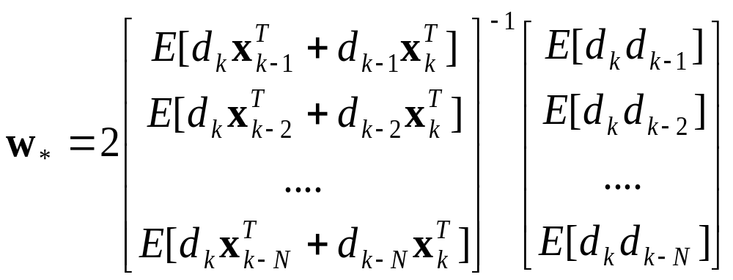
Optimal solution by root-finding
There is a single unique solution for the
equation
and
.

Slide 40
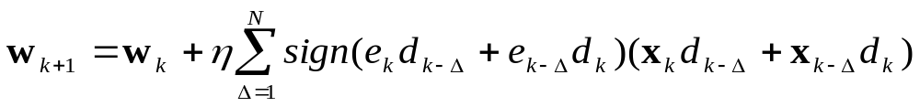
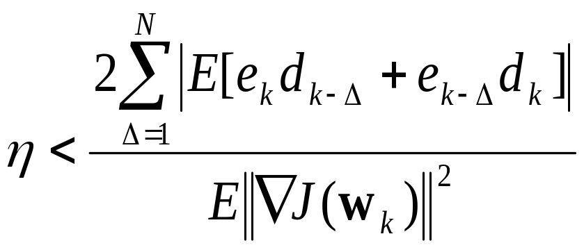
Stochastic algorithm
Asymptotically converges to the optimal solution iff

Slide 41
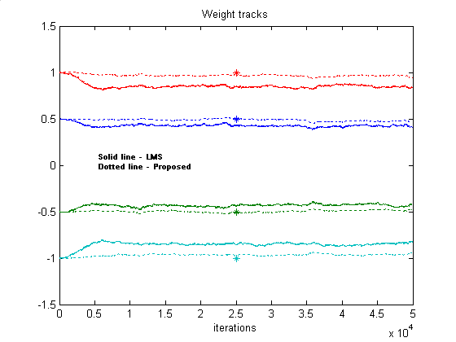
Local stability
10dB input SNR 10dB output SNR

Slide 42
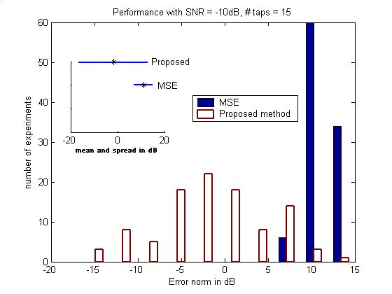
System ID in colored input noise
-10dB input SNR & 10dB output SNR (white noise)

Slide 43
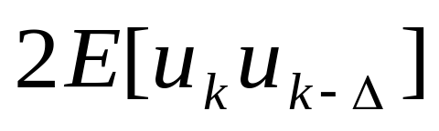
Extensions to colored noise in desired signal
If the noise in desired signal is colored, then
Introduce a penalty term in the cost function
such that the overall cost converges to

Slide 44
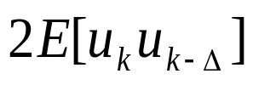
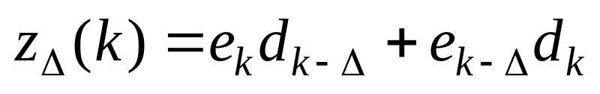
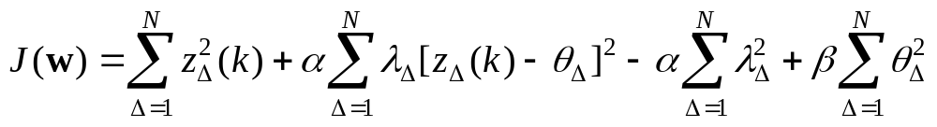
But, we do not know
Introduce estimators of in the cost!
Define
The constants α and β are positive real
numbers that control the stability

Slide 45


Gradients…

Slide 46

Parameter updates

Slide 47

Convergence
0dB SNR for both input and desired data

Slide 48
Summary
Noise is everywhere
MSE is not optimal even for linear systems
Proposed AEC and its extensions handle noisy data
Simple online algorithms optimize AEC

Slide 49
Proposal-current
Work in progress
In dissertation
Further analysis of AEC
  Multiple lags
  Faster algorithms using augmented Lagrangian
  Minimum-norm update rules
  Recursive EWC using minor components analysis
Analysis of under-modeling and overestimation effects
Proposed new methods for parameter estimation in colored noise
Mathematical analysis of convergence

Slide 50
Proposal-current
Work in progress
In dissertation
Application to the design of inverse controllers
Application of the proposed criteria/algorithms
  Model-order estimation based on error correlations
  Model-order estimation using sparseness constraints
  AEC with β > 0 for error smoothing

Slide 51
Future Thoughts
Complete analysis of the modified algorithm
Extensions to non-linear systems
  Difficult with global non-linear models
  Using Multiple Models ?
Unsupervised learning
  Robust subspace estimation
  Clustering ?
Other applications

Slide 52
Selected publications
Book chapter
Error Whitening Wiener Filters: Theory and Algorithms
(Chapter 10) in Least-Mean-Square Adaptive Filters, Haykin, Widrow (eds), Wiley, Sep 2003.
Journal papers
Stochastic Error Whitening Algorithm for Linear Filter Estimation with Noisy Data
Neural Networks, vol. 16, no. 5-6, pp. 873-880, Jun 2003.
2. Error Whitening Criterion for Adaptive Filtering – Theory and Algorithms
IEEE Transactions on Signal Processing (to appear)
3. On Newton-type and Minor Components Based Learning Algorithms for Parameter Estimation with Noisy Data
NeuroComputing, (invited, due March 2004)

Slide 53
Selected publications
Accurate Linear Parameter Estimation in Colored Noise (in preparation)
Patents
Error Whitening Criterion for Linear Parameter Estimation in White Noise (submitted – Feb, 2003)
2. Algorithms for parameter estimation in colored noise using Augmented Lagrangian (in preparation)
Conference papers
Fast Error Whitening Algorithms for System Identification and Control, Proceedings of NNSP’03, pp. 309-318, Sep 2003.
Error Whitening Criterion for Linear Filter Estimation, Proceedings of IJCNN’03, vol. 2, pp. 1447-1452, Jul 2003.
Accurate Linear Parameter Estimation in Colored Noise, ICASSP’04 (accepted)

Slide 54
Acknowledgements
Dr. Jose C. Principe
Dr. Deniz Erdogmus
Dr. Petre Stoica

Slide 55
Thank You!

